Slide 1
IP Addressing

Slide 2
IP Addressing
Logical addresses are 32 bits (4 bytes) long
Each byte is represented as an octet (decimal number from 0 to 255)
Usually represented in dotted decimal notation
E.g., 172.24.208.192
Address has two parts: network and host ID
E.g. 172.24.208.192 (172.24.0.0 and 208.192)
Categorized into ranges referred to as classes
Class system provides basis for determining which part of address is the network and which is the host ID
The first octet of an address denotes its class

Slide 3
IP Addressing (continued)
Classes
Class A: first octet between 1-126
16,777,214 hosts per network address
Class B: first octet between 128-191
65,534 hosts per network address
Class C: first octet between 192-223
254 hosts per network address
Class D: first octet between 224-239
Reserved for multicasting
Class E: first octet between 240-255
Reserved for experimental use

Slide 4
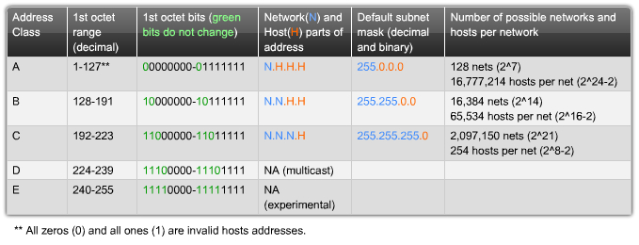
IP Addressing

Slide 5
IP Addressing (continued)
127.0.0.0 network is called the loopback address
localhost always corresponds to address 127.0.0.1
APIPA (Automatic Private IP Address)
169.254.0.0/24 (class C address)
IETF reserved addresses for private networks
Class A addresses beginning with 10
Class B addresses from 172.16 to 172.31
Class C addresses from 192.168.0 to 192.168.255
These addresses can’t be routed across the Internet
IPv6 eliminates need for private addressing; provides a 128-bit address (vs. IPv4’s 32 bits)

Slide 6
Subnet Masks
Subnet mask determines which part of address denotes network portion and which denotes host
32-bit number
A binary 1 signifies that the corresponding bit in the IP address belongs to the network portion; a 0 signifies that bit in address belongs to host portion
Default subnet mask uses a 255 in each octet in address that corresponds to the network portion
Class A: 255.0.0.0
Class B: 255.255.0.0
Class C: 255.255.255.0

